Slide 1
2021 RFI Survey Toolkit
Results from the 2021 CBO-Health Care Contracting Survey

Slide 2
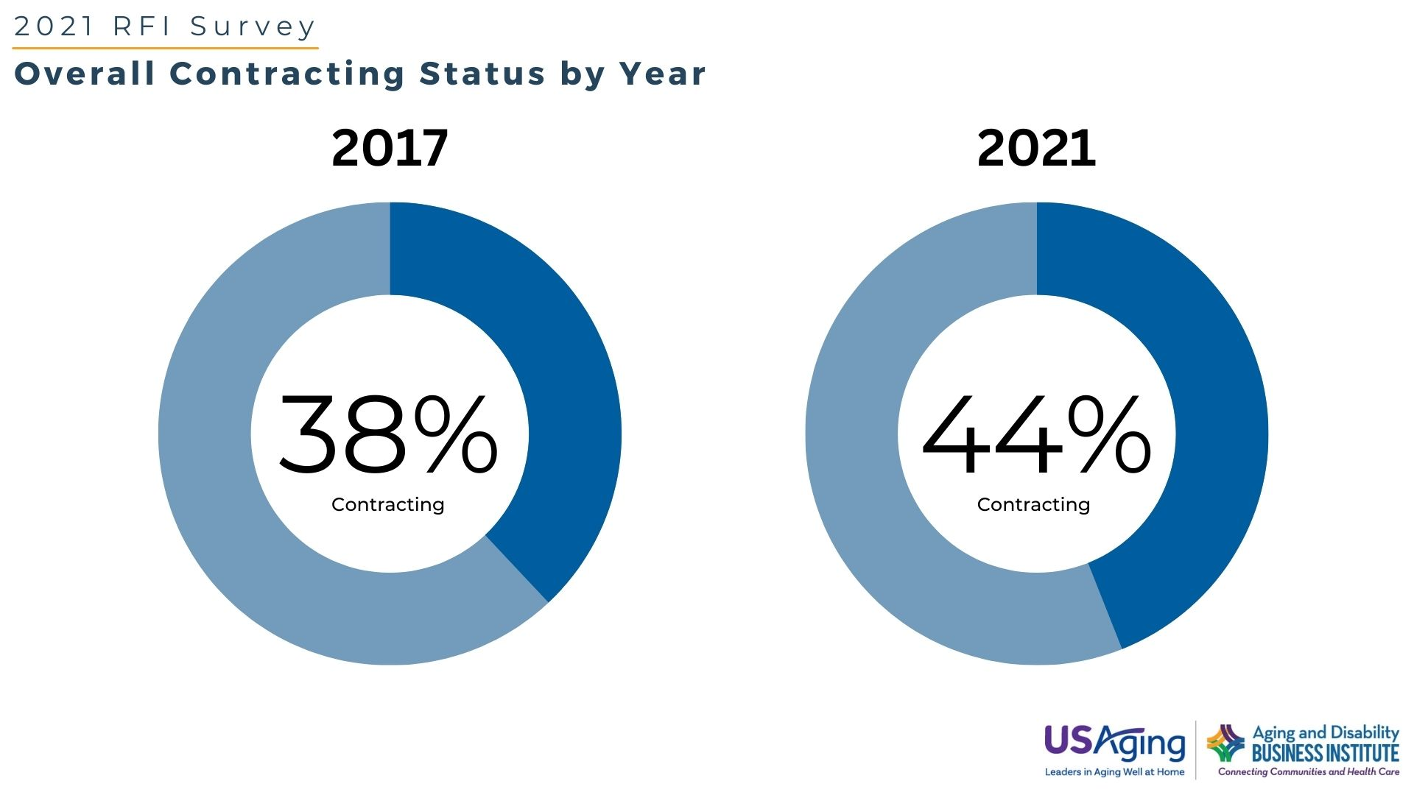
2
The data used in this graph was collected through a survey conducted by Scripps Gerontology Center at Miami University on behalf of the Aging and Disability Business Institute, led by USAging. For more information, visit http://ow.ly/842K50IsrYA
Notes:
In this survey, a contract was defined as a legally binding or otherwise valid agreement between two or more entities with the intent to exchange payment for services or programs.
As a reminder, for the purposes of this survey, we are interested in contracts in which your CBO or network receives payment from the health care entity.
Does your organization currently participate in a contract to provide services or programs with or on behalf of a health care entity? (Click one.)
This question was asked of all respondents.
RFI 2017 n=593
RFI 2021 n=572

Slide 3
The data used in this graph was collected through a survey conducted by Scripps Gerontology Center at Miami University on behalf of the Aging and Disability Business Institute, led by USAging. For more information, visit http://ow.ly/842K50IsrYA
Notes:
Question: Did you enter into any of your contracts as part of a network?
In this survey, a network was defined as a coordinated group of community-based organizations that pursues a regional or statewide contract with a health care entity.
This question was asked only of respondents with contracts.
RFI 2021 n=92
RFI 2017 n=44

Slide 4
The data used in this graph was collected through a survey conducted by Scripps Gerontology Center at Miami University on behalf of the Aging and Disability Business Institute, led by USAging. For more information, visit http://ow.ly/842K50IsrYA
Notes:
Thinking about all of your contracts with health care entities, please indicate whether you participate in a contract that includes any of the following plans, payers, or providers. Please select all partners with whom you have a contract. Additional instructions for CBOs in networks: For each contract partner, please indicate if your CBO contracts directly with the health care entity, or if the contract is through the network. If you have a direct contract and contract through a network for a specific type of partner, please check both. Please select all partners and contracting types.
Percentages on this slide reflect CBOs contracting individually or through networks. This question was asked only of respondents with contracts.
n=211

Slide 5
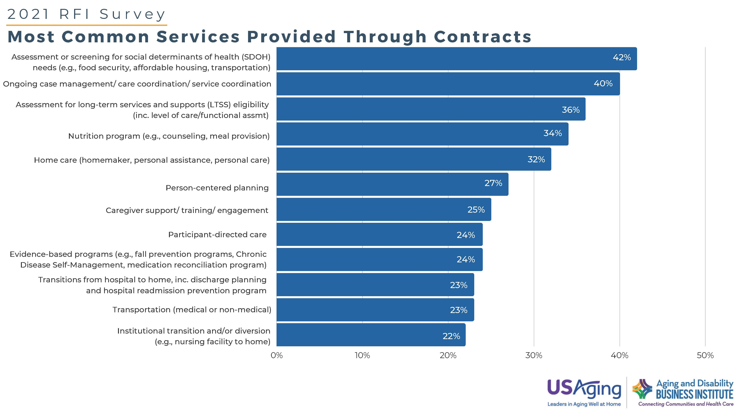
The data used in this graph was collected through a survey conducted by Scripps Gerontology Center at Miami University on behalf of the Aging and Disability Business Institute, led by USAging. For more information, visit http://ow.ly/842K50IsrYA
Notes:
Please indicate whether you offer these services or programs through any of your contracts with a health care entity. (Select all that apply.)
Additional instructions for CBOs in networks: For each service, please indicate if the service is provided through a contract directly with a health care entity, or through a contract as part of a network. If you offer a service through direct contracts and contracts through networks, please check both. Please select all services and contracting types.
Percentages on this slide reflect CBOs contracting individually or through networks. This question was asked only of respondents with contracts.
n=204

Slide 6
The data used in this graph was collected through a survey conducted by Scripps Gerontology Center at Miami University on behalf of the Aging and Disability Business Institute, led by USAging. For more information, visit http://ow.ly/842K50IsrYA
Notes:
Which, if any, of the following high-risk or high-need groups are targeted in your contracts with health care entities? (Click all that apply.)
This question was asked only of respondents with contracts.
n=206

Slide 7
n=188
The data used in this graph was collected through a survey conducted by Scripps Gerontology Center at Miami University on behalf of the Aging and Disability Business Institute, led by USAging. For more information, visit http://ow.ly/842K50IsrYA
Notes:
Thinking about all of your contracting efforts to date, if you could inform other agencies working toward contracting of the biggest challenges you faced in establishing the contract, which of the following challenges would you select? Click up to seven challenges in the first column. In the second column, please select the seven biggest challenges that you continue to face in your contract relationships.
This question was only asked of respondents with contracts.
n=189

Slide 8
The data used in this graph was collected through a survey conducted by Scripps Gerontology Center at Miami University on behalf of the Aging and Disability Business Institute, led by USAging. For more information, visit http://ow.ly/842K50IsrYA
Notes:
Which of the following changes related to contracting with health care entities were most significant for your organization? (Click up to five changes.)
This question was only asked of respondents with contracts.
n=184

Slide 9
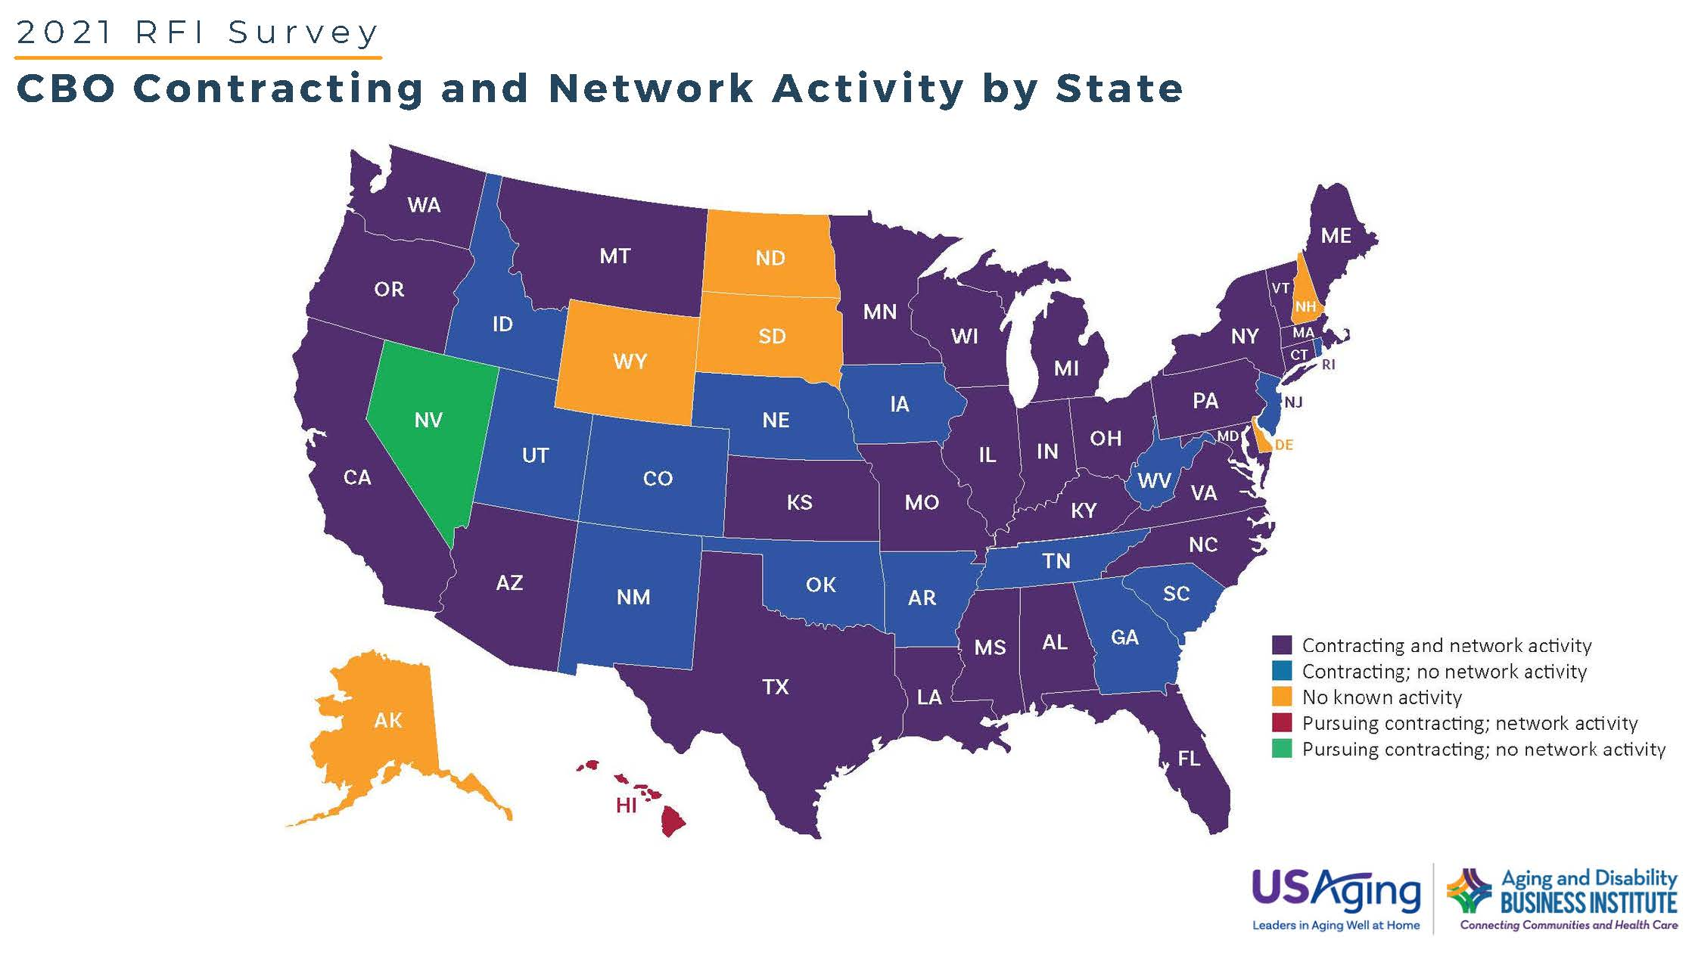
The data used in this graph was collected through a survey conducted by Scripps Gerontology Center at Miami University on behalf of the Aging and Disability Business Institute, led by USAging. For more information, visit http://ow.ly/842K50IsrYA
Notes:
Which of the following changes related to contracting with health care entities were most significant for your organization? (Click up to five changes.)
This question was only asked of respondents with contracts.
n=184

