Slide 1


Applicant Webinar: Medicare Advantage Learning Collaborative
Kathleen A. Cameron, Senior Director, Center for Healthy Aging, National Council on Aging
Marisa Scala-Foley, Director, Aging & Disability Business Institute, n4a
Sharon Williams, CEO, Williams Jaxon Consulting, LLC
November 13, 2019

Slide 2

Welcome!
Objectives for today’s webinar:
Introduce NCOA and n4a
New opportunities in Medicare Advantage for state and community-based organizations
Share information about the Medicare Advantage Learning Collaborative
Q&A

Slide 3
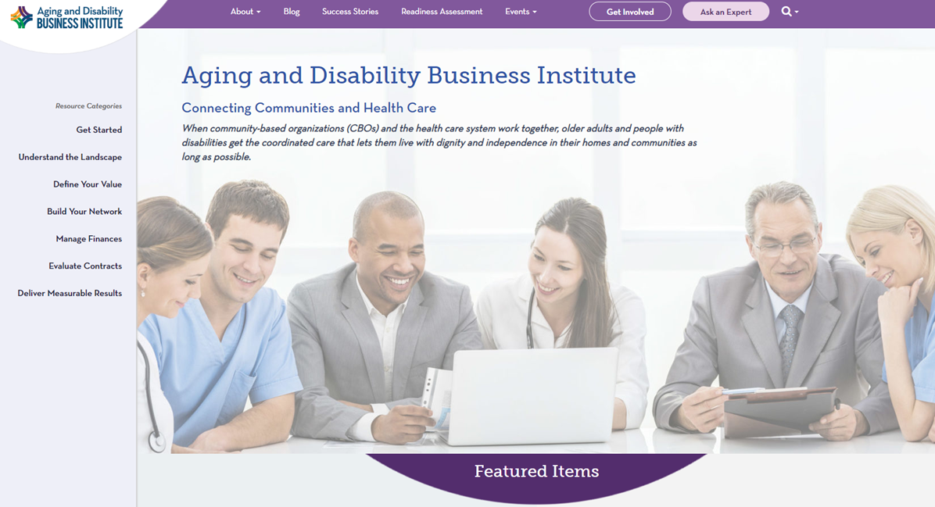

The Aging & Disability Business Institute
www.aginganddisabilitybusinessinstitute.org

Slide 4










Our Funders
Our Partners

Slide 5

NCOA’s Center for
Healthy Aging
Goal: Increase the quality and years of healthy life for older adults and adults with disabilities
Two national resource centers funded by the Administration for Community Living
  Chronic Disease Self-Management Education (CDSME)
  Falls Prevention
Other key areas: behavioral health, physical activity, immunizations, oral health

Slide 6
New Opportunities in
Medicare Advantage
2018 Creating High-Quality Results and Outcomes Necessary to Improve Chronic (CHRONIC) Care Act
  CMS Updates policy on Medicare Advantage (MA) plan supplemental benefits
  Developments in managed long-term services and supports and dual demonstration projects continue to transform health care delivery and quality outcomes
As of 2017, one-third of the 57 million Medicare beneficiaries were enrolled in Medicare Part C or MA plans
Enrollment in MA plans is projected to increase to 42% by 2030
Uptick in enrollment in Dual Special Needs plans will top MA plan growth

Slide 7
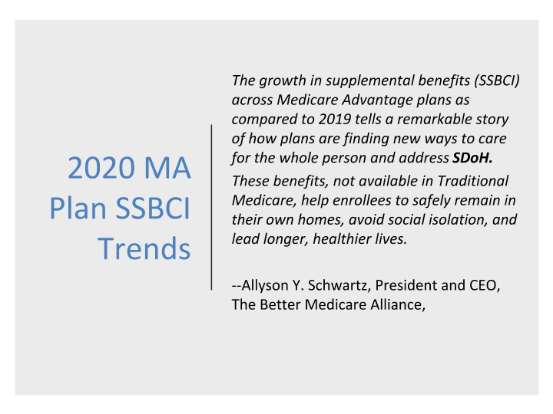

Slide 8
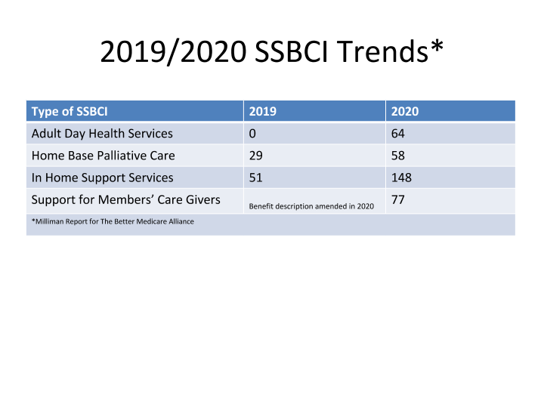

Slide 9
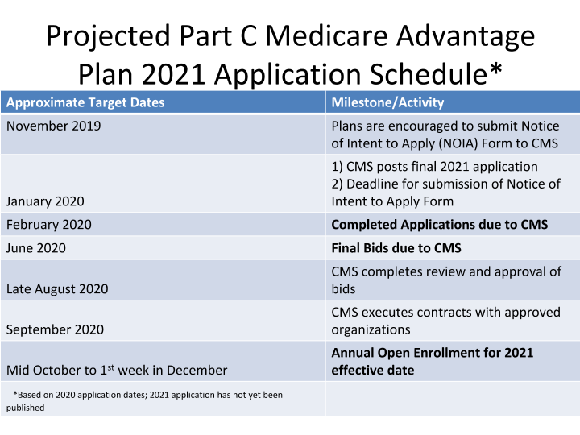

Slide 10
Key Learning Benchmarks
Increase knowledge of Medicare Advantage plans and requirements for contracting.
Gain understanding about the Medicare Advantage Special Supplemental Benefits for the Chronically Ill (SSBCI)
Learn how to evaluate and prioritize contracting opportunities with Medicare Advantage plans.
Increase knowledge of Medicare Advantage plans and requirements for contracting.
Utilize the n4a Readiness Assessment Tool to strengthen strategic planning.
Identify a Medicare Advantage plan target.
Develop a customizable value proposition to present to a Medicare Advantage plan.

Slide 11
Participant Benefits
A no-cost, significant investment in the long-term sustainability of your organization or network.
Over 12 hours of content delivered over the 6-month period, paired with defined action steps to help you create transformation. Content will be delivered through two-hour monthly webinars featuring lectures from industry experts, an in-person meeting, peer-to-peer learning, and discussion of suggested readings and homework assignments.
Access to a private online community to connect with peers and resources.
One on one technical assistance with each participating organization.

Slide 12
Participant Expectations
Complete the entire six-month MALC curriculum
Events:
Actively participating during monthly webinars, including reporting on progress and lessons learned to encourage shared growth among all participants.
Attending an in-person meeting in April 2020 in the Washington DC area. Travel costs for up to two members per learning collaborative participant will be covered.
Participating in one-on-one technical assistance call at the midpoint of the learning collaborative.
Tasks:
Collaborating with your team to develop measurable goals and objectives to achieve the MALC purpose;
Dedicating 4-5 hours per month to prepare for monthly MALC lectures and homework assignments;
Actively and regularly participating in ongoing discussions on the online community;
Submitting homework assignments and progress report updates on time each month through the online community;
Becoming familiar with the community-integrated health care resources on n4a’s Aging and Disability Business Institute and NCOA’s Roadmap to Community Integrated Health Care as well as other supplemental materials;
Completing an evaluation survey at the conclusion of the learning collaborative.

Slide 13
You might also be interested in….
NCOA resources:
Roadmap to Community-Integrated Health Care
Aging & Disability Business Institute resources:
Policy Brief: New Federal Law and Rules Open Door for Integrated Care in Medicare Advantage
Webinar: The CHRONIC CARE Act: New Opportunities to Advance Complex Care Through Community-Clinical Partnerships
Webinar: CBO Partnership Opportunities with MA Plans

Slide 14


Slide 15
Contact Information
MALC Application
Kathleen Zuke
571-527-3955
kathleen.zuke@ncoa.org

